Slide 1

Work Experience
Department for Transport
West Coast Market Team
Rail Strategy and Service Group

Slide 2
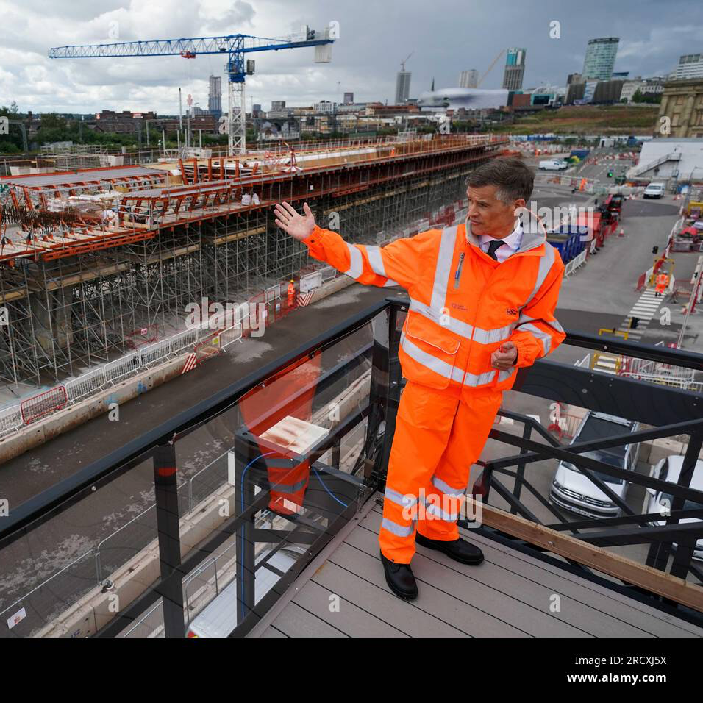
Introduction to DfT and the civil service
What is the department for transport?
Dft is a ministerial department controlled by the secretary of state (Mark Harper) and his team.
He visited the offices in Birmingham on the first day of work experience.
They are responsible for creating ways to maintain and fund existing transport services and develop new major transport schemes such as Hs2.
What is the civil service?
The civil service provides services to people directly all over the country, such as transport or even running prisons.
What is a civil servant?
A person who is employed by a government department.
e.g. Anyone employed in DfT is a civil servant.

Slide 3
Social Mobility Project
What was the aim of this project?
To help people growing up in lower income brackets and offering them work experience as a way of levelling the field with students who have contacts and resources available.
What we did to help achieve this aim:
Worked with the Head of Social Mobility and another work experience student to create a plan and presentation.
This plan included all the costs needed to travel and stay overnight at all 11 areas being visited.
The presentation showed different ways into the civil service and explained why we are doing this.
Social mobility pp(1).pptx
business case (1)(2).docx

Slide 4
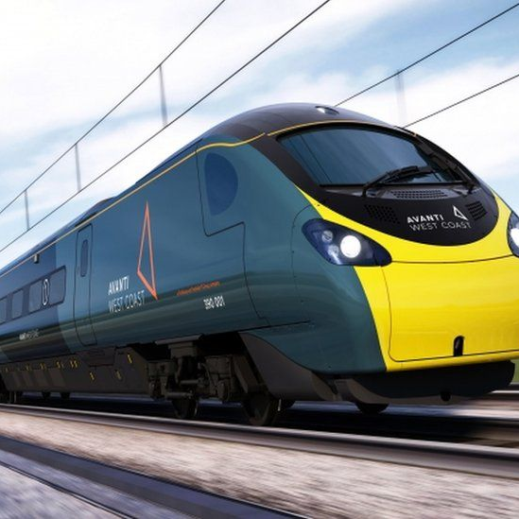
What else did we do?
I had the opportunity to experience what it is like working from home and in an office environment.
I was able to meet people of all different roles all the way up to the Head of the West Coast Partnership team on the last day.
We were able to visit the head offices of Avanti West Coast and got to see inside the control room.
Avanti West coast connects six of the UK’s largest cities: London, Birmingham, Liverpool, Manchester, Glasgow, and Edinburgh.

Slide 5
What I gained from this work experience
An understanding of what DfT and the civil service is.
Experiencing what it is like to work from home and in the offices in Birmingham.
Was able to work well as part of a team to complete a project.
Positive feedback from everyone we met.
A new network of contacts I can call on for any advice.
New career possibilities to think about.
Reference/ thank you letter.

